Slide 1
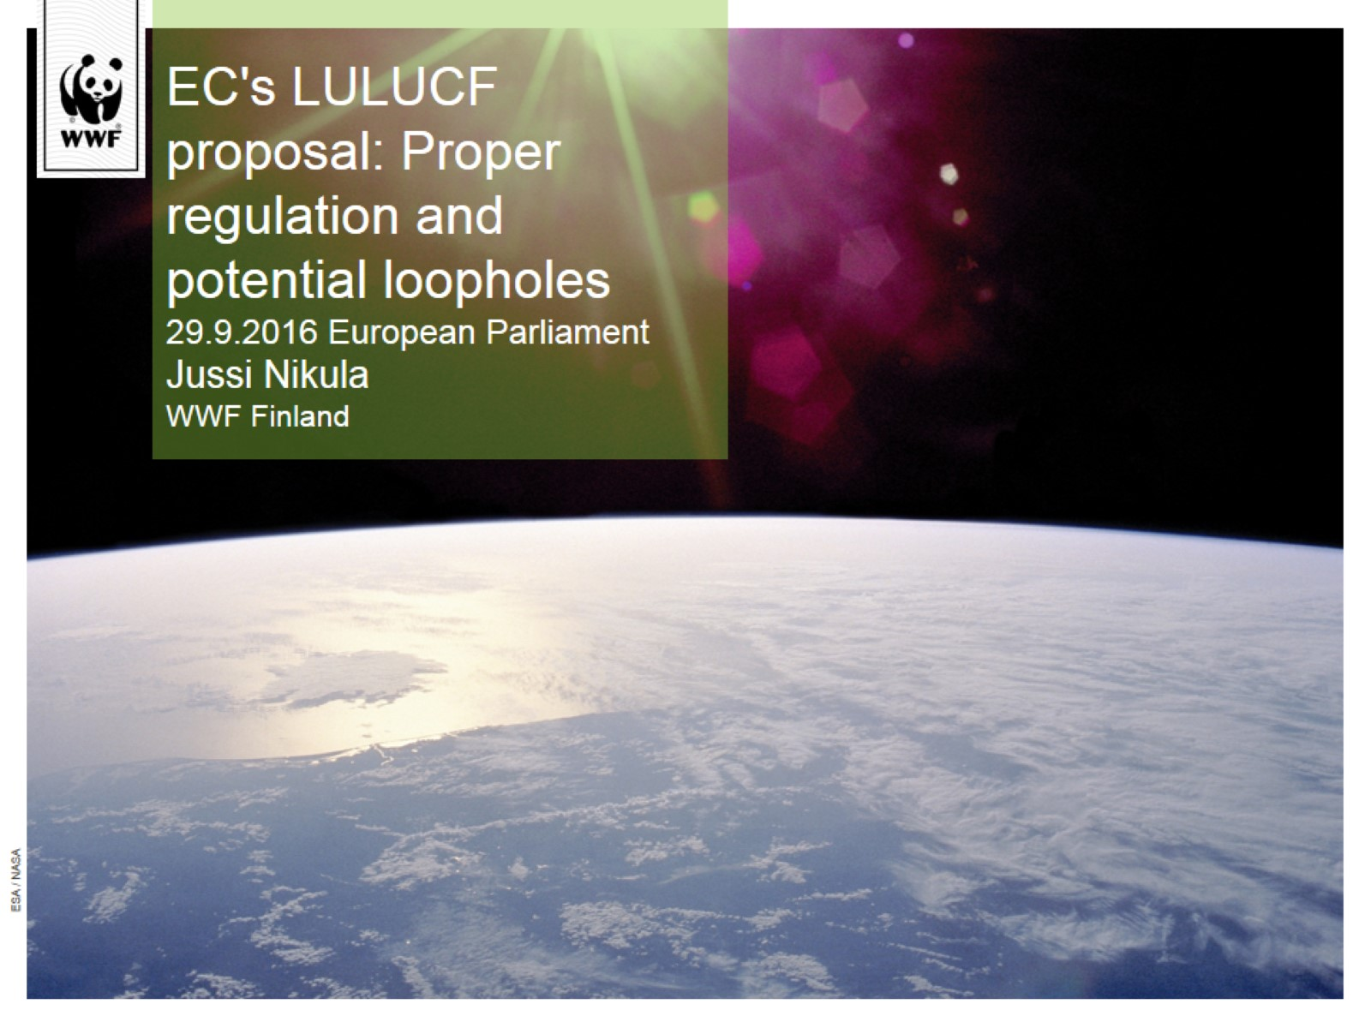
EC's LULUCF proposal: Proper regulation and potential loopholes 29.9.2016 European Parliament Jussi Nikula WWF Finland

Slide 2
The green gold of Finland

Slide 3
The LULUCF proposal: Promising framework to maintain carbon sinks – but there are potential loopholes

Slide 4
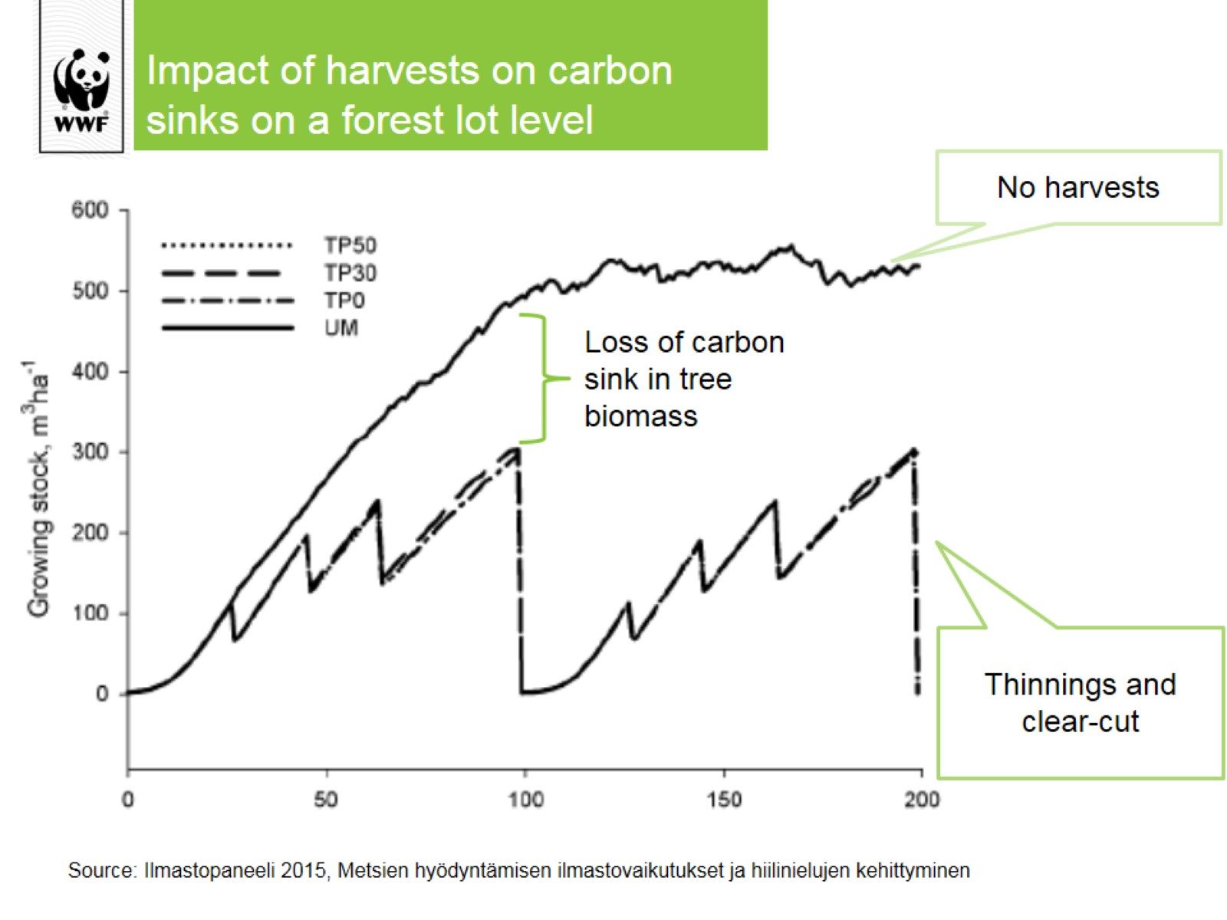
Impact of harvests on carbon sinks on a forest lot level

Slide 5
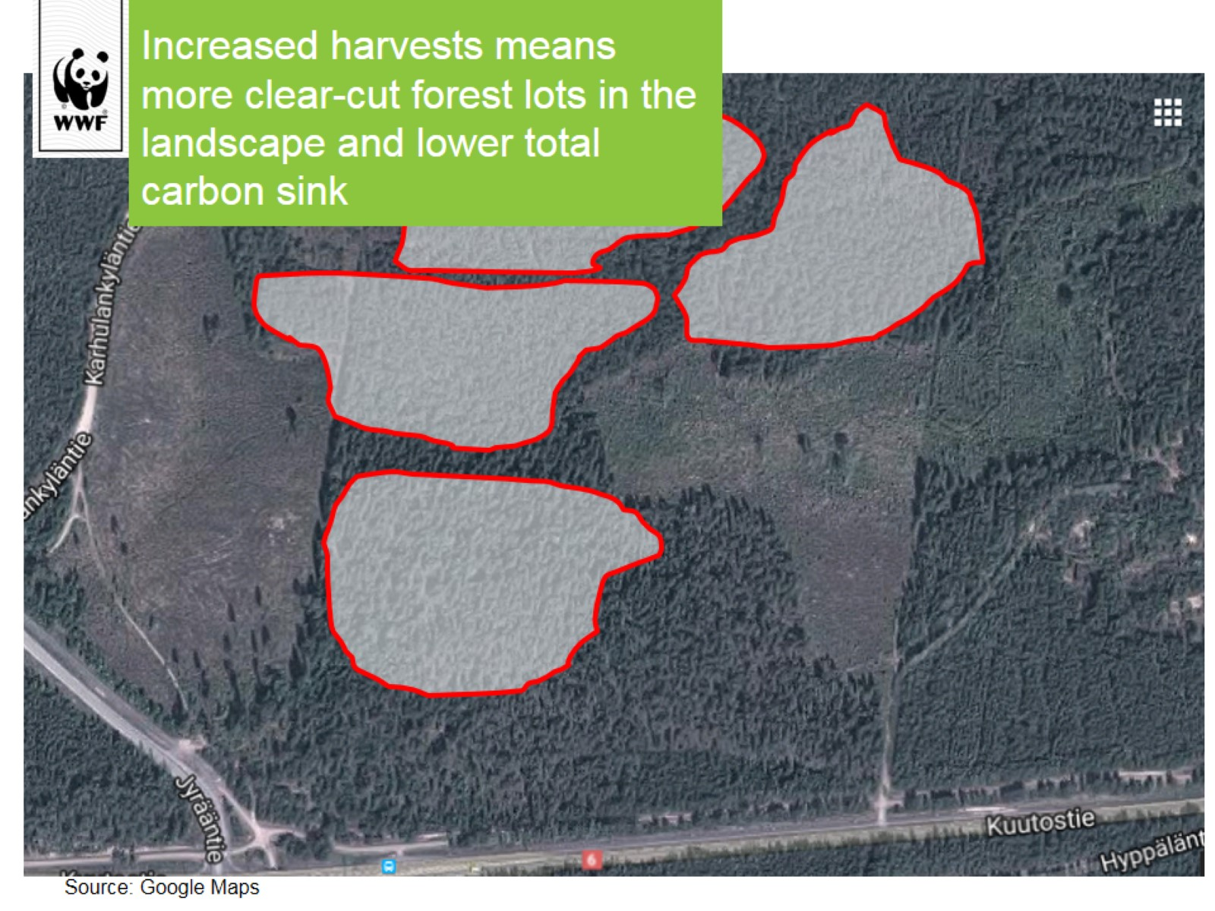
Increased harvests means more clear-cut forest lots in the landscape and lower total carbon sink

Slide 6
“It is exceptionally unlikely that the wood utilization in Finland provides significant unit reductions in net carbon emissions within the upcoming 100 years”

Slide 7
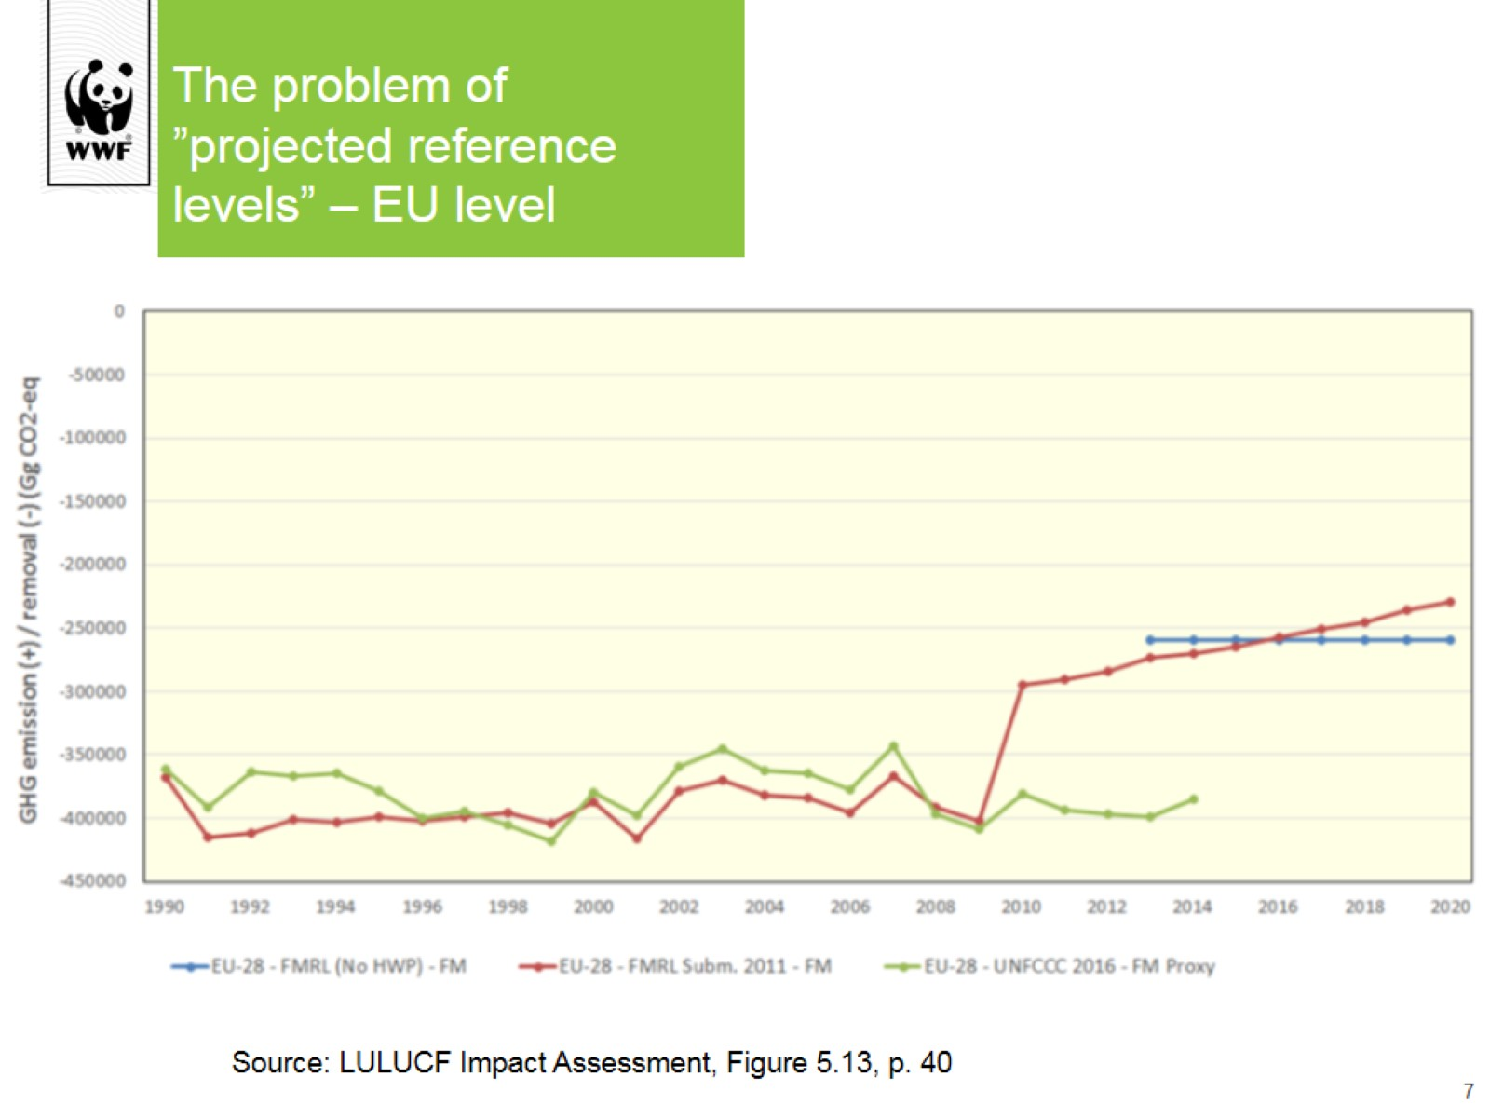
The problem of ”projected reference levels” – EU level

Slide 8
Setting the reference level – Theoretical example of Finland

Slide 9
Notes for the MEPs

Slide 10
Myth of sustainable forestry – biodiversity in decline

